Slide 1
336018 – נושאים מתקדמים בהנדסה ביורפואית 4: מדעי המידע ולמידת מכונה בהנדסה ביורפואית Data science and machine learning in bio-medical engineering
Lecture 4a
Introduction to machine learning

Slide 2
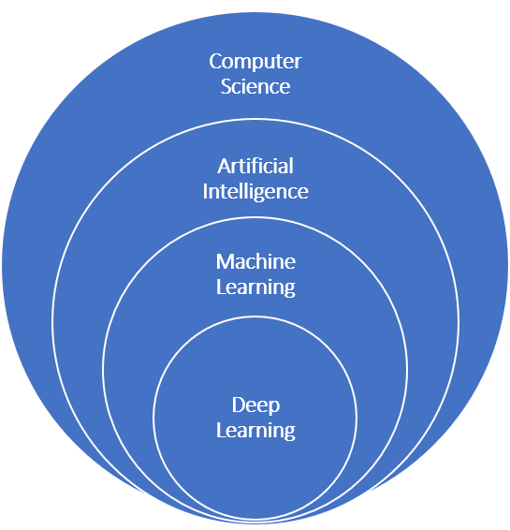
The age of the Deep Learning hype
Some definitions:
Machine Learning: A family of algorithms for finding patterns in data.
Supervised learning – labeled data
Unsupervised learning – unlabeled data
Reinforcement learning – strategy optimization
Deep Learning: A sub-family of supervised learning algorithms, based on “deep artificial neural networks”

Slide 3
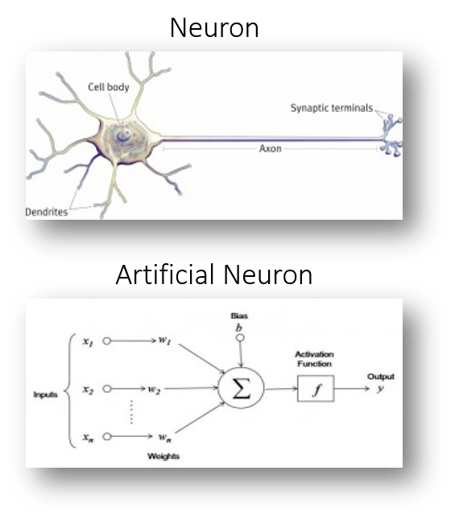
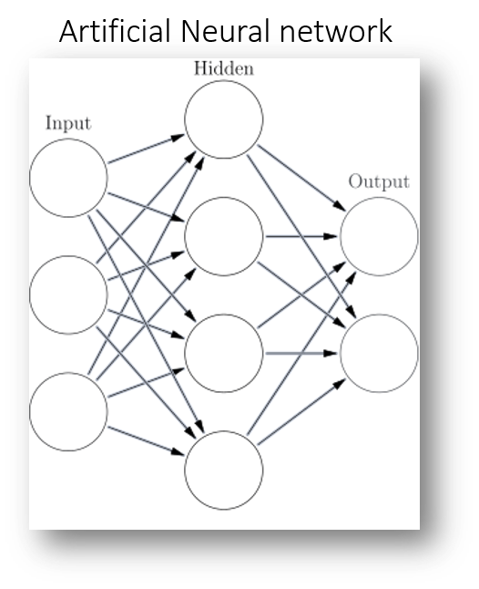
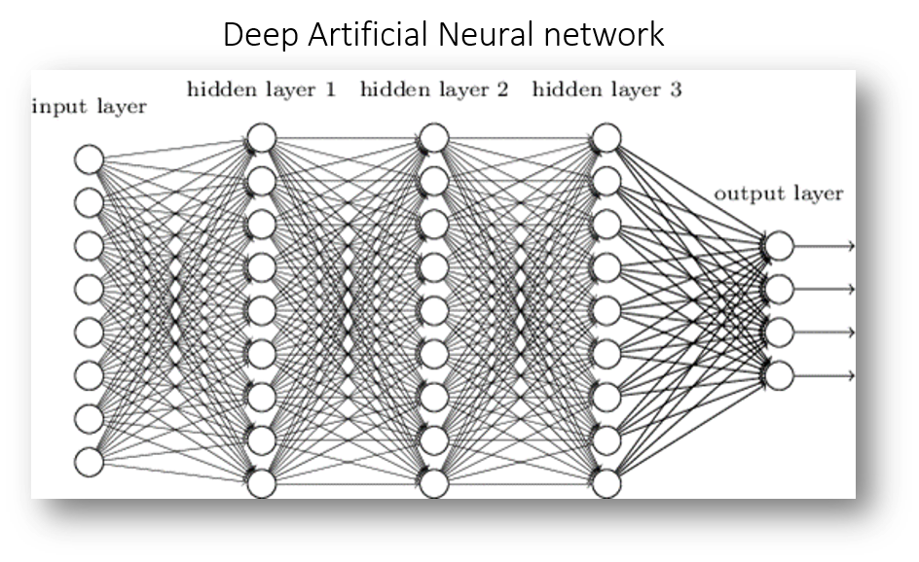
Artificial neural networks

Slide 4
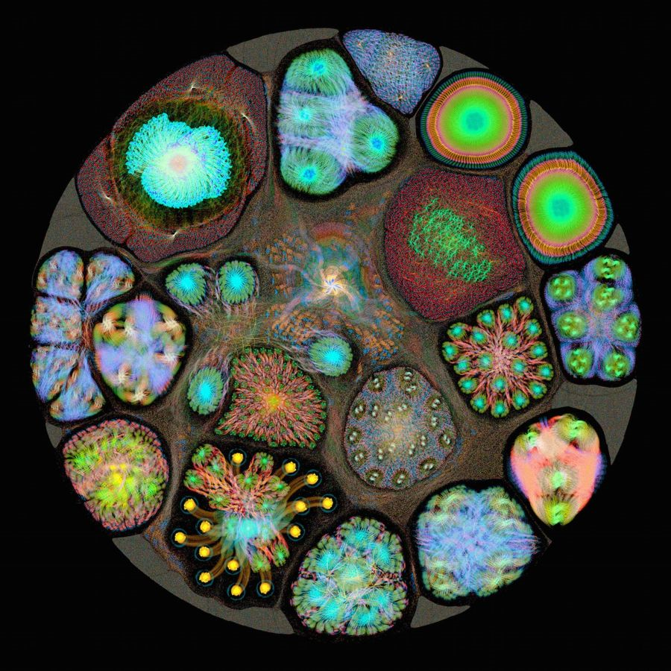
State of the art – Deep convolutional neural networks
Already outperforming humans in:
Strategic decision making
Chess
Go
Autonomous vehicles
Speech recognition/translation
Google Translate
Baidu
Most of all:
Image classification
Source:
graphcore.ai

Slide 5
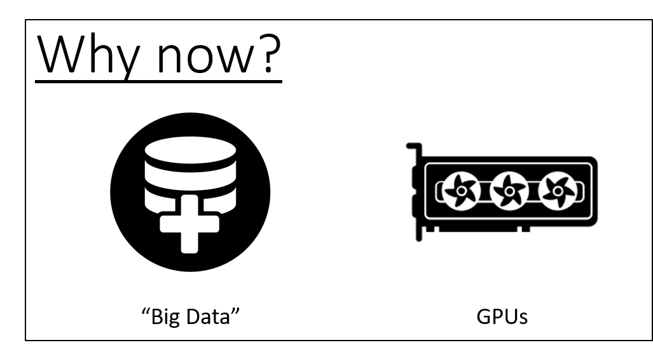
“Deep learning is the new electricity”
transforming every major industry
Non healthcare industries:
Web / Search / E-Commerce
Automotive
Banking / Insurance
Aerospace / Drones
Logistics
Cybersecurity
Agriculture
Healthcare:
Genomics / Precision medicine
Pharma / Drug discovery
Medical diagnostics

Slide 6
Yes, but…
What IS machine learning?!

Slide 7
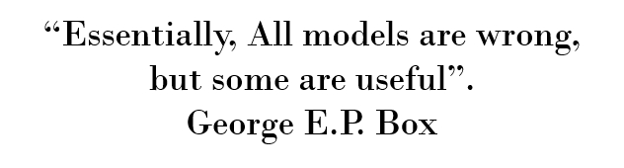
What is machine learning (ML)?
Automated/algorithmic methods for finding patterns in data.
The idea is to create a model for the data, and learn the parameters of model directly from the data.

Slide 8
Categories of machine learning
Supervised learning
Models that can predict labels based on labeled training data (predictive)
Further separated into two families:
Classification: Models that predict labels as two or more discrete categories
Regression: Models that predict continuous labels
Unsupervised learning
Models that identify structure in unlabeled data (descriptive)
Further separated into two families:
Clustering: Models that detect and identify distinct groups in the data
Dimensionality reduction: Models that detect and identify lower-dimensional structure in higher-dimensional data
Semi-supervised learning
Used when the data has incomplete labels
Usually an iterative procees
Reinforcement learning
Used for learning behavior strategies
Can be supervised or unsupervised

Slide 9
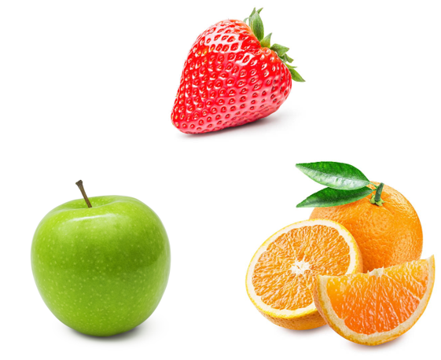
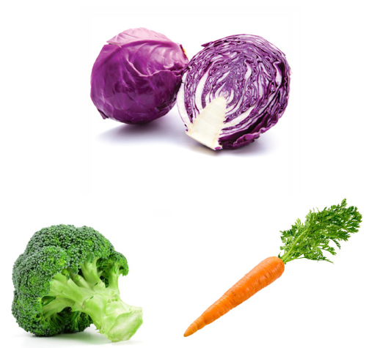

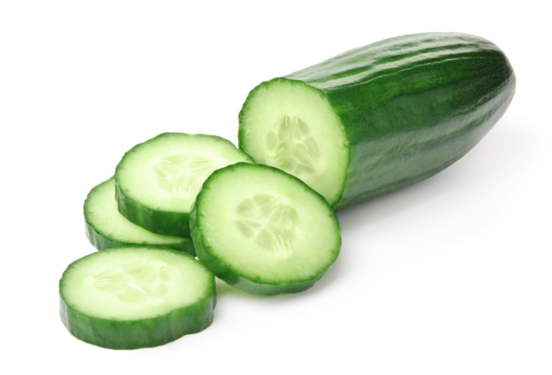
Classification example

Slide 10
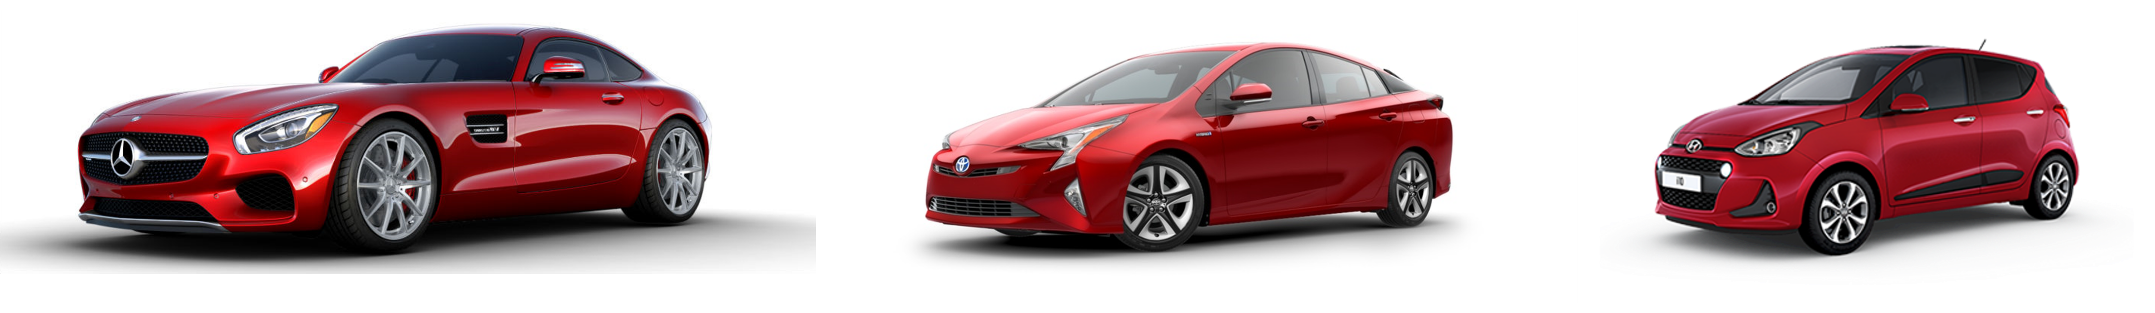
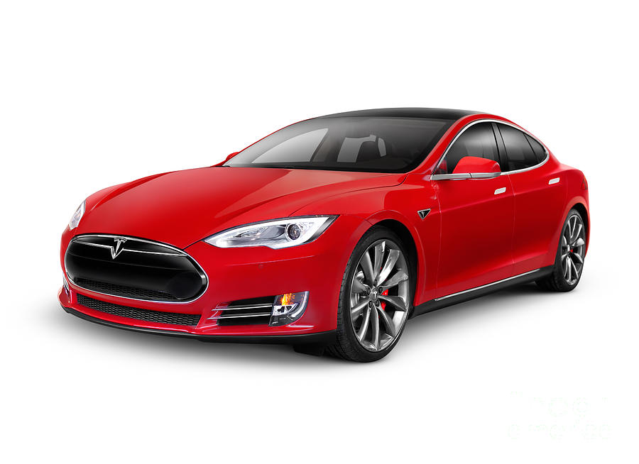
Regression example
$160K
$25K
$15K
$?

Slide 11
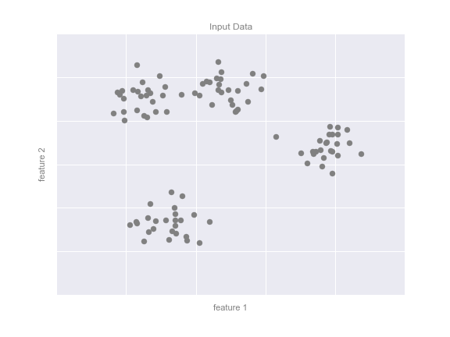
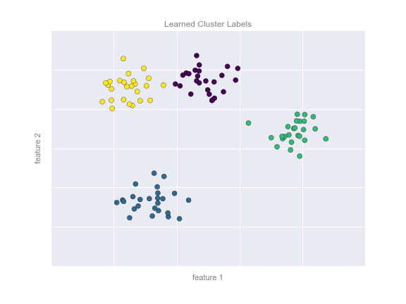
Clustering example

Slide 12
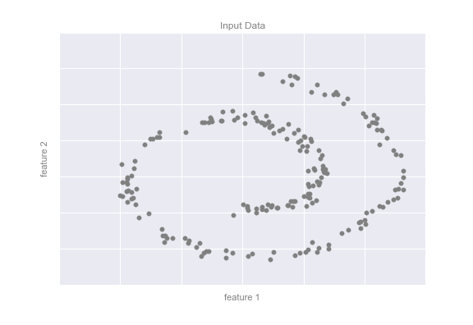
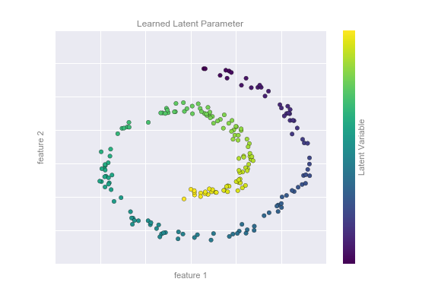
Dimensionality reduction example

Slide 13
The components of a learning algorithm
Dataset
Model
Cost function
Optimization algorithm

Slide 14
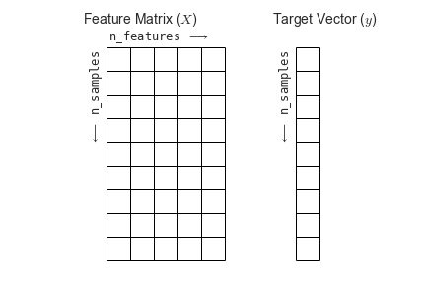
The dataset
We assume this will be in the form of “tidy data”, meaning an m-by-n matrix representing m observations, where each observation has n features.
For supervised learning, we also assume a label vector of size m.

Slide 15
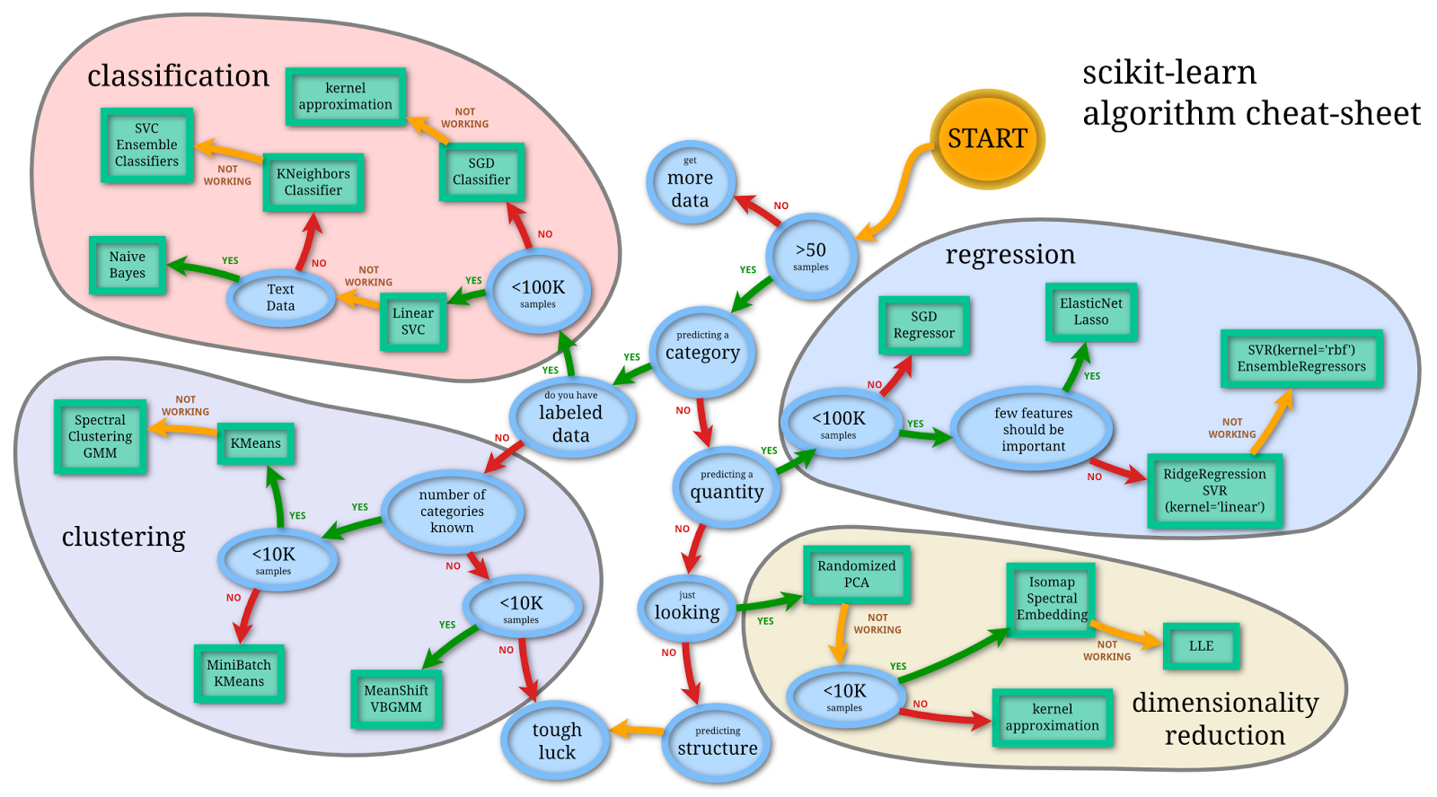
The model

Slide 16
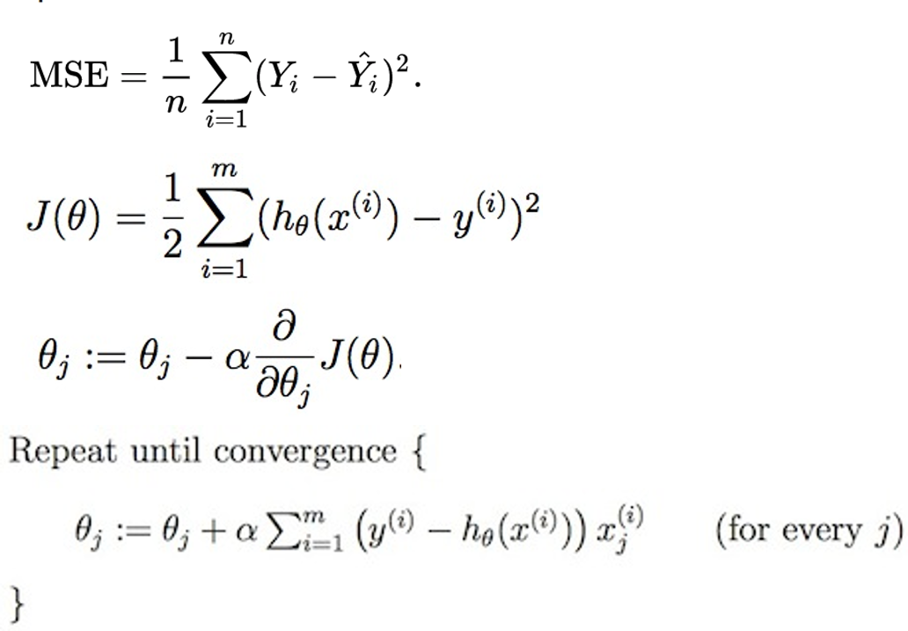
Under the hood
All ML algorithms are performing some variation of a classic optimization problem:
A cost function J(ɵ) (sometime called an objective function) is defined (e.g. mean square error) to calculate how badly the model h_{ɵ}(x) is mis-predicting the labels y.
An initial random value is given to the parameters and the cost is calculated.
Then an iterative optimization process is performed, changing the parameters to minimize the cost – this is the learning process, characterized by a learning rate ɑ.
The most commonly used optimization algorithm is “gradient descent”, shown here. This method requires the cost function to be differentiable!

Slide 17
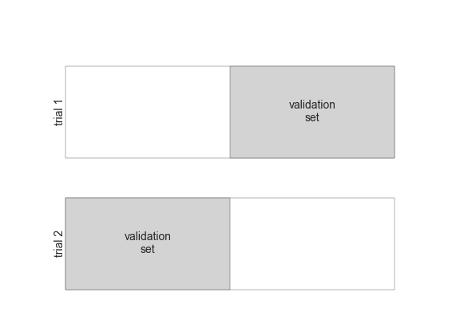
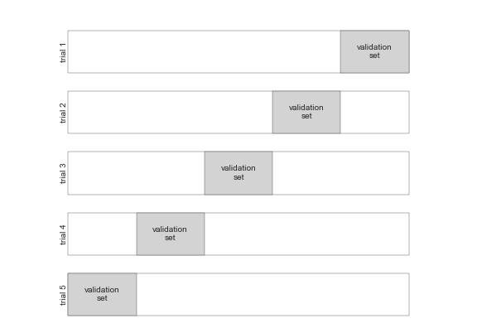
Quantifying the performance of a supervised learning algorithm
The purpose of training a predictive model is to learn a mapping from the features (X) to the label (Y), in order to apply that mapping to unseen examples and accurately predict the label. This is known as “generalization”.
We do this by separating our data into a “training set” and a “test set” (sometimes called a holdout set or a validation set). We train the model using only the training set, and compare the training error with the test error (also called the generalization error) using some performance metric.
Training and testing on different validation sets is called “cross-validation”.

Slide 18
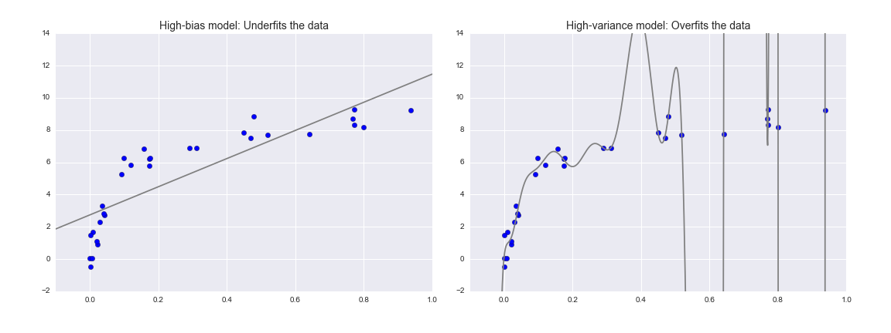
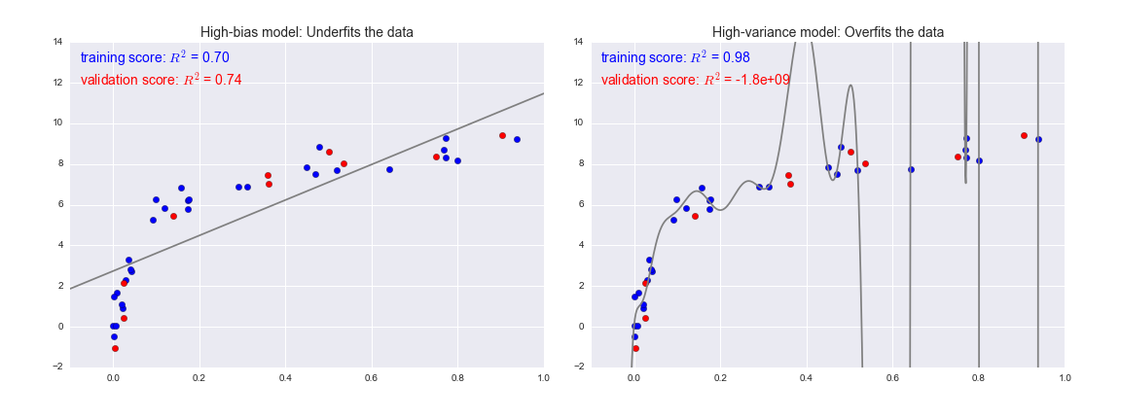
Choosing the best model
High bias model:
Underfits the data
High variance model:
Overfits the data
If our estimator is underperforming, how should we move forward? There are several possible answers:
Use a more complicated/more flexible model
Use a less complicated/less flexible model
Gather more training samples
Gather more data to add features to each sample
Sometimes using a more complicated model will give worse results, and adding more training samples may not improve your results!

Slide 19
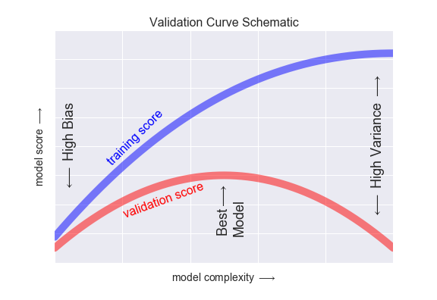
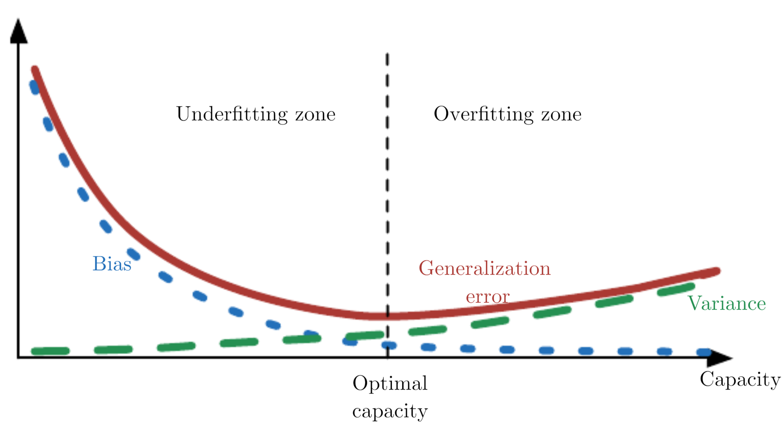
The bias-variance trade-off
The training score is everywhere higher than the validation score. This is generally the case: the model will be a better fit to data it has seen than to data it has not seen.
For very low model complexity (a high-bias model), the training data is under-fit, which means that the model is a poor predictor both for the training data and for any previously unseen data.
For very high model complexity (a high-variance model), the training data is over-fit, which means that the model predicts the training data very well, but fails for any previously unseen data.
For some intermediate value, the validation curve has a maximum. This level of complexity indicates a suitable trade-off between bias and variance.

Slide 20
Back to the notebook
ML in python with scikit-learn

